Slide 1


Human Resources Analytics
Sylvester Brown
Regis University
Practicum I

Slide 2
Introduction

Slide 3
Purpose of Project
Showcase
Data Exploration
Visualization
Machine learning

Slide 4
HR Dataset
Dataset: Human Resource
Kaggle.com
https://www.kaggle.com/colara/humanresource
William Walter
14,999 Employee

Slide 5
The 10 Categories
Satisfaction level
Last evaluation
Number of project
Average monthly hours
Time spent in company
Work accident
left (whether the employee has left)
Promotion last 5years
department
salary

Slide 6
Focus of Analysis
what main characteristics contribute to the reason of why employees are leaving?
Which learning model appears to be better for predicting which employees will leave.

Slide 7
Data Analysis

Slide 8
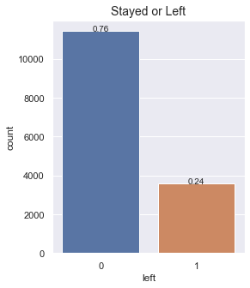

Slide 9
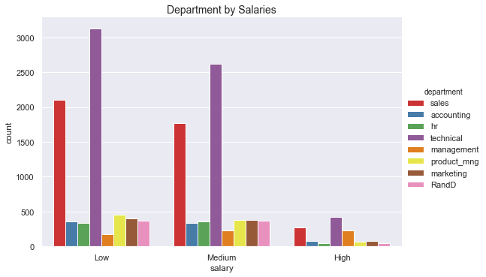

OBSERVATION
Most of the employees of the technical department have low or medium salaries.
Sales department is in the second place where most of the employees receives low and medium salaries.

Slide 10
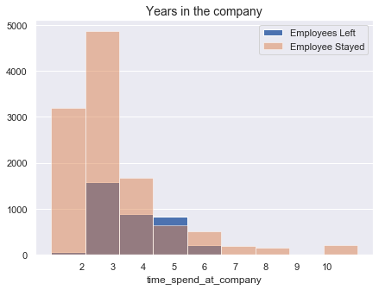
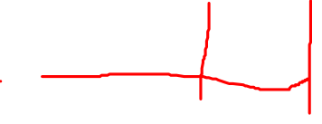
OBSERVATION
Employees with 7 or more years did not leave.
In year 1, new hires hardly leave the company, if they do the number is very low. The problem starts when the employees have more than 3 years and get worst when they achieve 5 years.

Slide 11
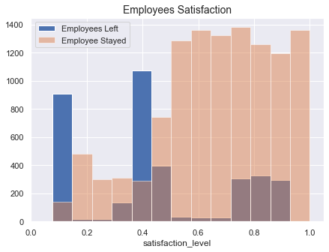
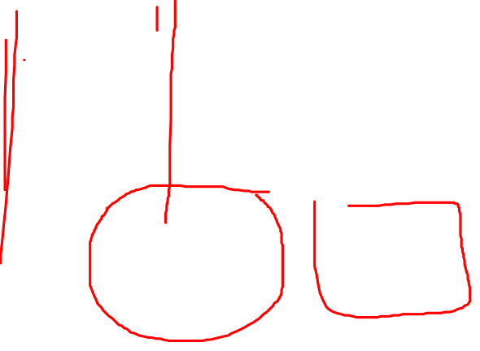
OBSERVATION
We have a peak at about 0.1 satisfaction level. These are employees who are totally disappointed.
Another peak at 0.4 satisfaction level, representing another group with the satisfaction level below the average.
And another amount in the range 0.7 and 0.9, with employees that left, although the high satisfaction.

Slide 12
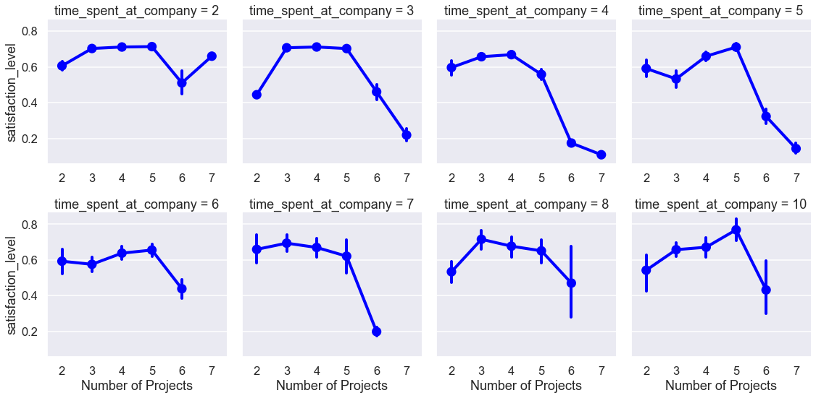

OBSERVATION
It appears clear that there is a drop in satisfaction when employees are working on 6 or more projects.

Slide 13
Summary of the Exploratory Data Analysis
It is a relatively young company, on average, employees have 3 or 4 years in the company and the oldest employee has been working there for 10 years.
In five years only 2% of the employees were promoted. Is possible that many employees get unmotivated and start planning to leave.
Employees with 7 or more years in the company did not left. Employees with 5 years have a greater chance to leaving. Management may have to plan an incentive package to retain employees who work for five years.
The employees with 4 years in the company have the lowest average satisfaction level of all the company with (0.47).
The satisfaction drops when the employees are working on 5 or more projects. A number of 3 or 4 projects seems to be ideal independent of the time spent in the company.

Slide 14
Machine Learning

Slide 15
Model comparison
Model | Training Score | Testing Score
4 | Random Forest | 0.997714 | 0.989778
3 | Decision Tree | 0.998476 | 0.988667
1 | SVM | 0.966568 | 0.961778
2 | KNN | 0.972378 | 0.956889
0 | Logistic Regression | 0.790456 | 0.785778

Slide 16
Recommendation
Satisfaction level is the major impact on whether employees stay or leave the company.
Improve work life balance by having the right number of projects. Employees with 3-4 projects assigned tend to stay. Similarly, number of average hours a month plays a role in employees leaving or staying.
Provide training so that their evaluation score can improve. The data shows that employees with a low evaluation score are likely to leave.

Slide 17
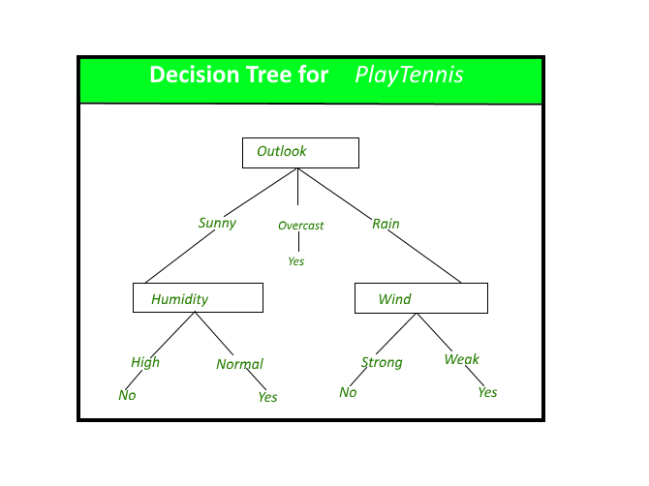
Decision Trees
Decision tree is the most powerful and popular tool for classification and prediction.
A Decision tree is a flowchart like tree structure, where each internal node denotes a test on an attribute.
Each branch represents an outcome of the test, and each leaf node (terminal node) holds a class label.

Slide 18

Decision Trees continued
Answers Sequential questions
“If this than that” conditions to yield specific results

Slide 19
Decision Trees
Pros
Cons
1. Easy to interpret and make for straightforward visualizations.
2. The internal workings are capable of being observed and thus make it possible to reproduce work.
3. Can handle both numerical and categorical data.
4. Perform well on large datasets
5. Are extremely fast
1. Building decision trees require algorithms capable of determining an optimal
2. Decision trees are prone to overfitting, especially when a tree is particularly deep choice at each node.

Slide 20
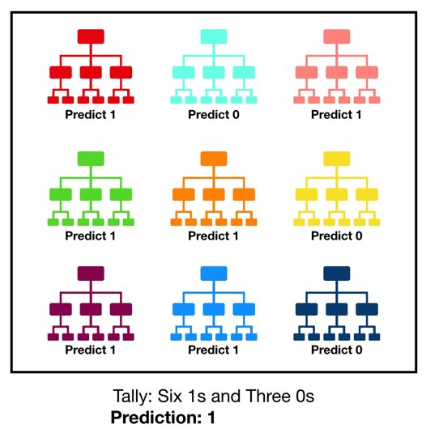
Random Forests
Random forest, like its name implies, consists of a large number of individual decision trees that operate as an ensemble.
Each individual tree in the random forest spits out a class prediction and the class with the most votes becomes our model’s prediction

Slide 21
Random Forests
Pros
Cons
The predictive performance can compete with the best supervised learning algorithms
They provide a reliable feature importance estimate
They offer efficient estimates of the test error without incurring the cost of repeated model training associated with cross-validation
An ensemble model is inherently less interpretable than an individual decision tree
Training a large number of deep trees can have high computational costs (but can be parallelized) and use a lot of memory
Predictions are slower, which may create challenges for applications

Slide 22
References
Gupta, S. (n.d.). Decision Tree. Retrieved from Geeks for Geeks; A computer science portal for geeks: https://www.geeksforgeeks.org/decision-tree/
Jansen, S. (n.d.). Hands-On Machine Learning for Algorithmic Trading. Retrieved from O'Reilly: https://www.oreilly.com/library/view/hands-on-machine- learning/9781789346411/e17de38e-421e-4577-afc3-efdd4e02a468.xhtml
Liberman, N. (2017, January 26). Decision Trees and Random Forests. Retrieved from Towards Data Science: https://towardsdatascience.com/decision-trees-and- random-forests-df0c3123f991
Yiu, T. (2019, June 12). Understanding Random Forest. Retrieved from Towards Data Science: https://towardsdatascience.com/understanding-random-forest-58381e0602d2

Slide 23
Other Resources Used
Used "Pandas for Everyone' by Daniel Chen
Researched various kennels
https://www.kaggle.com/colara/human-resources-analytics-a-descriptive-analysis
https://www.kaggle.com/daphnecor/predict-employee-turnover-rate-0
https://www.kaggle.com/henryshtang/hr-data-exploration
https://www.kaggle.com/rhuebner/human-resources-data-set/kernels

